Slide 1
National Asthma and Chronic Obstructive Pulmonary Disease Audit Programme (NACAP)
Wales primary care clinical audit 2021
Key findings and recommended improvement priorities

Slide 2

Key findings and recommended improvement priorities

Slide 3

Audit participation
Asthma and chronic obstructive pulmonary disease (COPD) primary care data in Wales were extracted from 314 general practices in October 2021 to capture activity from April 2020 up to 31 July 2021.
32,275 adults with COPD
84,583 adults with asthma
10,301 children and young people aged 6-18 with asthma
From 314 general practices in Wales

Slide 4
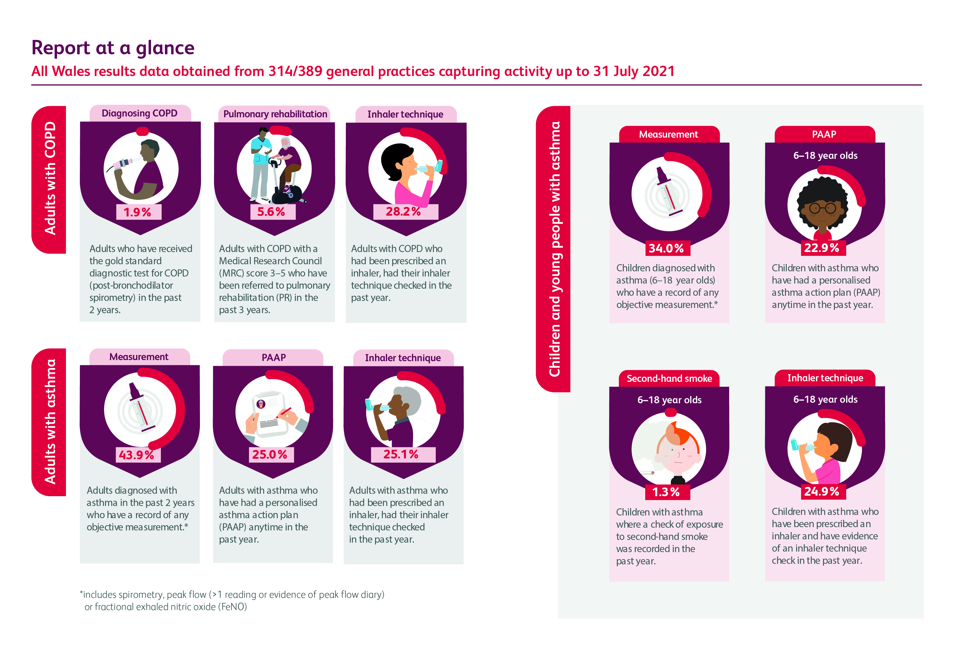

Slide 5



Demographics
Patient cohort |  |  | Average age
Adults with COPD | 49.3% | 50.7% | 70.4 years
Adults with asthma | 39.7% | 60.3% | 51.7 years
Children and young people aged 6-18 with asthma | 56.8% | 43.2% | 12.2 years

Slide 6



Comorbidities
Most common physical comorbidities for adults with COPD:
Hypertension (52.1%)
Asthma (24.0%)
Obesity (22.2%)
Most common physical comorbidities for adults with asthma:
Atopy (54.8%)
Eczema (38.8%)
Allergic rhinitis (33.2%)
Most common physical comorbidities for children and young people with asthma:
Eczema (53.8%)
Hay fever (22.2%)

Slide 7
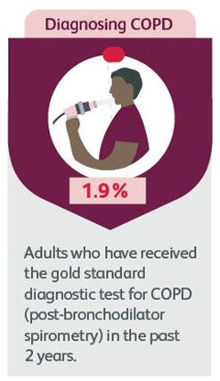
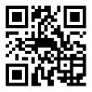

Getting the diagnosis right
Post-bronchodilator spirometry
1.9% of adults diagnosed with COPD in the past 2 years had a record of post-bronchodilator spirometry ratio >0.2 and <0.7.
Improvement Priority 1
Record post-bronchodilator spirometry ratio <0.7 for people on the COPD register. Ensure they have an accurate record in their notes including a spirometry trace, correct ratio and appropriate SNOMED code.
National target for Wales: 40% or more of people on the COPD register by April 2023
QR codes embedded within the clinical audit report and throughout this slideset direct to six QI projects which link directly to the QI priorities.

Slide 8
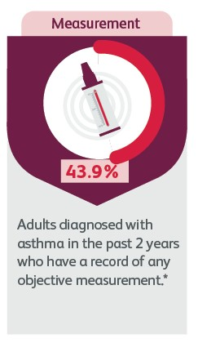
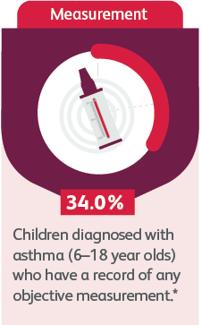
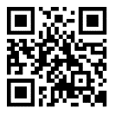
Getting the diagnosis right
Improvement Priority 2
Evidence and code appropriately objective variability for people diagnosed with asthma as demonstrated by at least one of the following:
Spirometric evidence of a significant FEV1 response to a short-acting beta-agonist (SABA) or after a trial of treatment with inhaled corticosteroids (ICS)
Oral corticosteroids (OCS) or prescription for ICS using medication codes in conjunction with significant reversibility
Objective variability
Evidence of significantly variable peak expiratory flow rate (PEFR)
Positive fractional exhaled nitric oxide (FeNO) result.
National target for Wales: 80% or more of people with asthma by April 2023.
43.9% of adults and 34.0% of children and young people diagnosed with asthma in the past 2 years had one or more objective measurement* ever recorded.
*Spirometry, peak flow with >1 reading/evidence of peak flow diary or FeNO test.

Slide 9
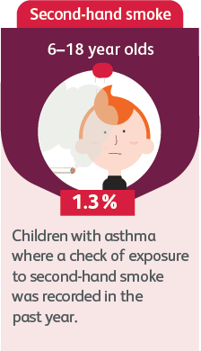

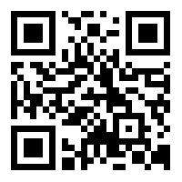
Assessing severity and future risk
Second-hand smoke exposure
1.3% of 6–18-year olds had a record of a check of exposure to second-hand smoke.
Improvement Priority 3
Ask parents about second-hand smoke exposure and provide very brief advice (VBA) at their children's asthma review. Evidence with the appropriate SNOMED code in the child’s notes.
National target for Wales: 20% or more of parents who have children and/or young people with asthma by April 2023.

Slide 10
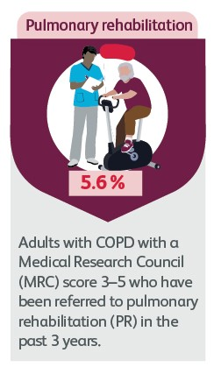
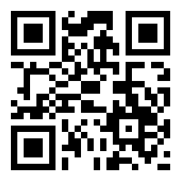
Providing high-value care
Referral to pulmonary rehabilitation (PR)
9,601 adults with COPD had an MRC score 3–5 in the past 3 years. 5.6% of these people were referred for PR.
Improvement Priority 4
Refer people with an Medical Research Council (MRC) score 3–5 to pulmonary rehabilitation (PR) and evidence this with the appropriate SNOMED code in their notes.
National target for Wales: 70% or more of people with COPD by April 2023.

Slide 11
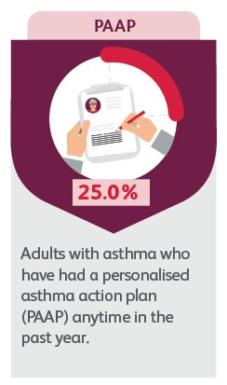
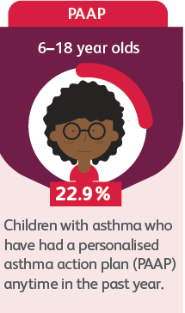
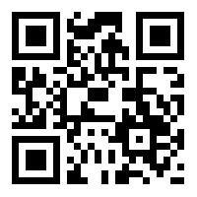
Providing high-value care
Improvement Priority 5
Provide people with asthma a personalised asthma action plan (PAAP) (written or electronic) and evidence this with the appropriate SNOMED code in their notes.
National target for Wales: 50% or more of people with asthma by April 2023
Personalised asthma action plan (PAAP)
PAAP in the past year:
25.0% of adults with asthma
22.9% of 6–18-year olds with asthma

Slide 12
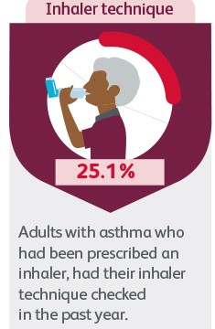
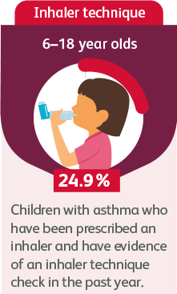
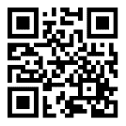
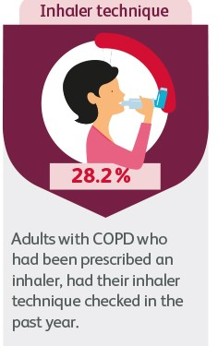
Providing high-value care
Asthma
Inhaler technique check
Prescribed an inhaler and had an inhaler technique check in the past year:
28.2% of adults with COPD
25.1% of adults with asthma
24.9% of 6–18-year olds with asthma
Improvement Priority 6
COPD
Evidence inhaler technique check in the last year for people with asthma and/or COPD with the appropriate SNOMED code in their notes.
National target for Wales: 70% or more of people with asthma and/or COPD by April 2023

Slide 13

How to use the results for quality improvement (QI)

Slide 14
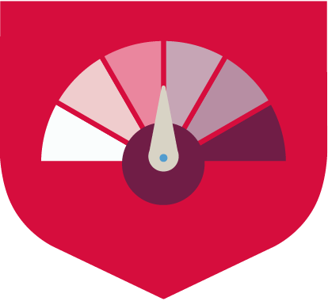
Getting started
QR codes embedded within the clinical audit report and on these slides direct to six QI projects which link directly to the primary care audit improvement priorities.
If these are implemented, they will result in significant improvement to the care and quality of life of your patients.
The pages include hosted video content about the audit data, the collective vision for improvement and how you can start to take small steps towards change.
For clinicians in Wales and West Yorkshire there is additional access to detailed education and QI resources which will take you through each of the six projects, step by step.

Slide 15

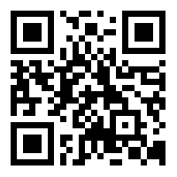
Improvement projects
1
Record post-bronchodilator spirometry ratio <0.7 for people on the COPD register. Ensure they have an accurate record in their notes including a spirometry trace, correct ratio and appropriate SNOMED code.
40%
2
Evidence and code appropriately objective variability for people diagnosed with asthma as demonstrated by at least one of the following:
Spirometric evidence of a significant FEV1 response to a short-acting beta-agonist (SABA) or after a trial of treatment with inhaled corticosteroids (ICS)
Oral corticosteroids (OCS) or prescription for ICS using medication codes in conjunction with significant reversibility
Evidence of significantly variable peak expiratory flow rate (PEFR)
Positive fractional exhaled nitric oxide (FeNO) result.
80%

Slide 16
QI projects
3
Ask parents about second-hand smoke exposure and provide very brief advice (VBA) at their children's asthma review. Evidence with the appropriate SNOMED code in the child’s notes.
20%
4
Refer people with an Medical Research Council (MRC) score 3–5 to pulmonary rehabilitation (PR) and evidence this with the appropriate SNOMED code in their notes.
70%
5
Provide people with asthma a personalised asthma action plan (PAAP) (written or electronic) and evidence this with the appropriate SNOMED code in their notes.
50%

Slide 17
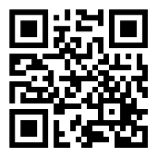
QI projects
6
Evidence inhaler technique check in the last year for people with asthma and/or COPD with the appropriate SNOMED code in their notes.
70%

Slide 18

National Asthma and Chronic Obstructive Pulmonary Disease Audit Programme (NACAP)
020 3075 1526
nacap@rcp.ac.uk
www.rcp.ac.uk/nacap
@NACAPaudit

