Slide 1
Focus on physicians: the UK 2025 workforce survey of consultant physicians
Produced by the RCP Medical Workforce and Data Insights team on behalf of the Federation of Royal Colleges of Physicians of the UK

Slide 2


The number of physicians in the UK
37,428
physicians working in general medical specialties*
8,484
higher specialty training doctors**
* physicians on the GMC specialist register who hold a licence to practise. Data from the GMC where doctors may be counted more than once if they hold specialist registration in more than one specialty
** data provided by the Joint Royal Colleges of Physicians Training Board

Slide 3



Who responded to the survey?
The survey was sent to respondents to the 2023 census, members of the three royal colleges of physicians, and publicised via
30 specialist societies and social media
2,038
physicians responded
94.1%
of respondents
were NHS consultants
5.9%
of respondents were SAS doctors*
*data on specialty, specialist and associate specialist (SAS) doctor responses will be published separately

Slide 4
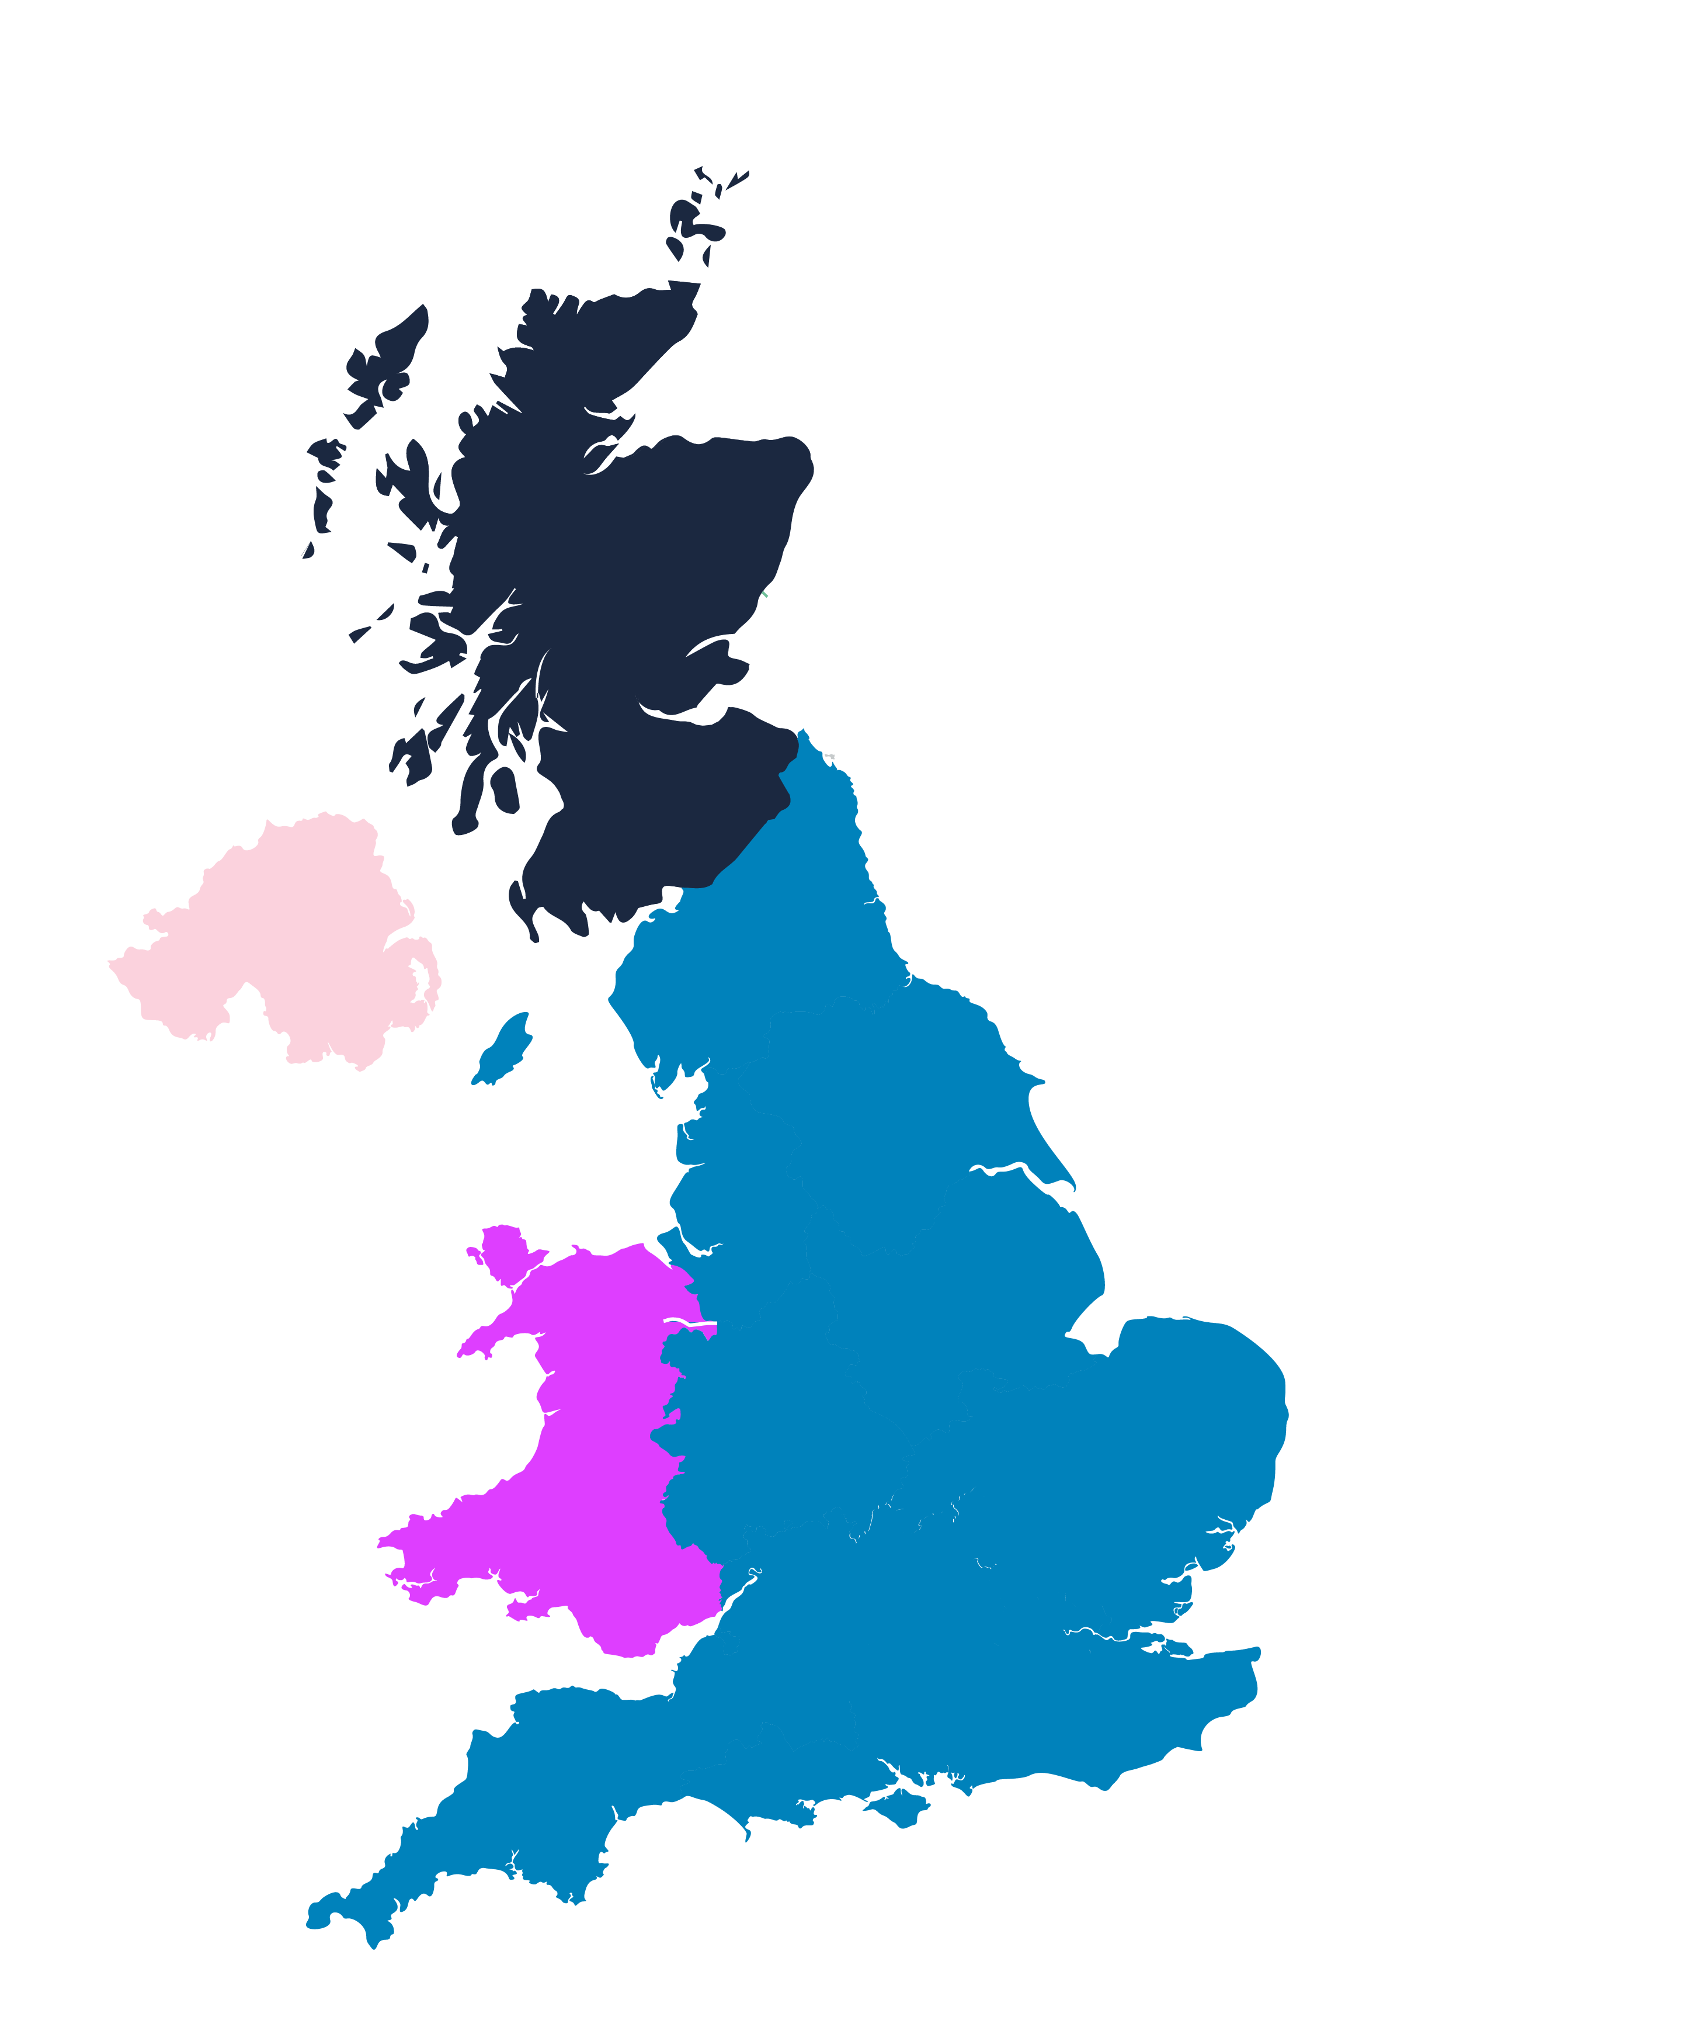
Consultant respondents by country
Response rate for each nation
Scotland
197 11%
Northern Ireland
40 2%
England
1,483 82%
Wales
82 5%

Slide 5
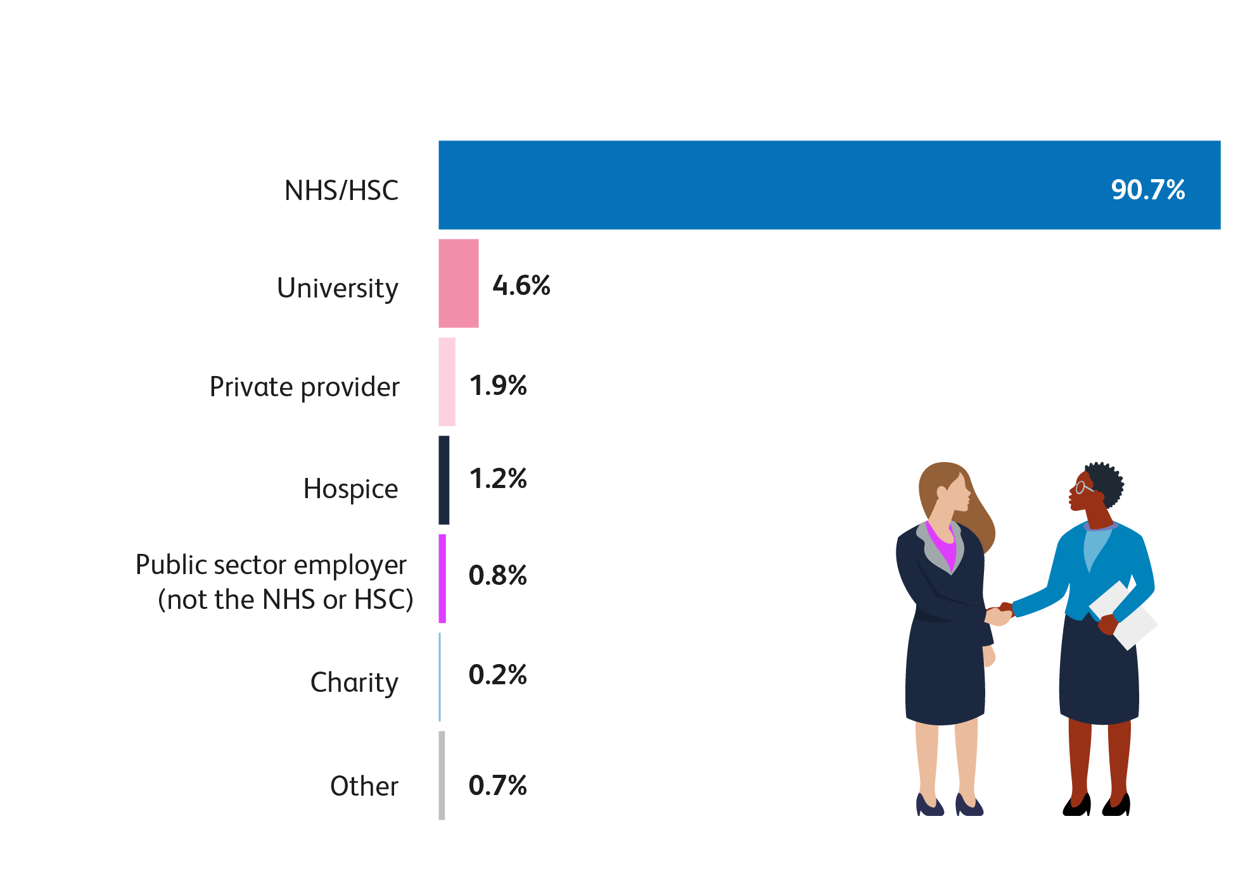
Who employs consultants?
Based on 1,802 consultant respondents
Notes:
CHART IN S/S

Slide 6
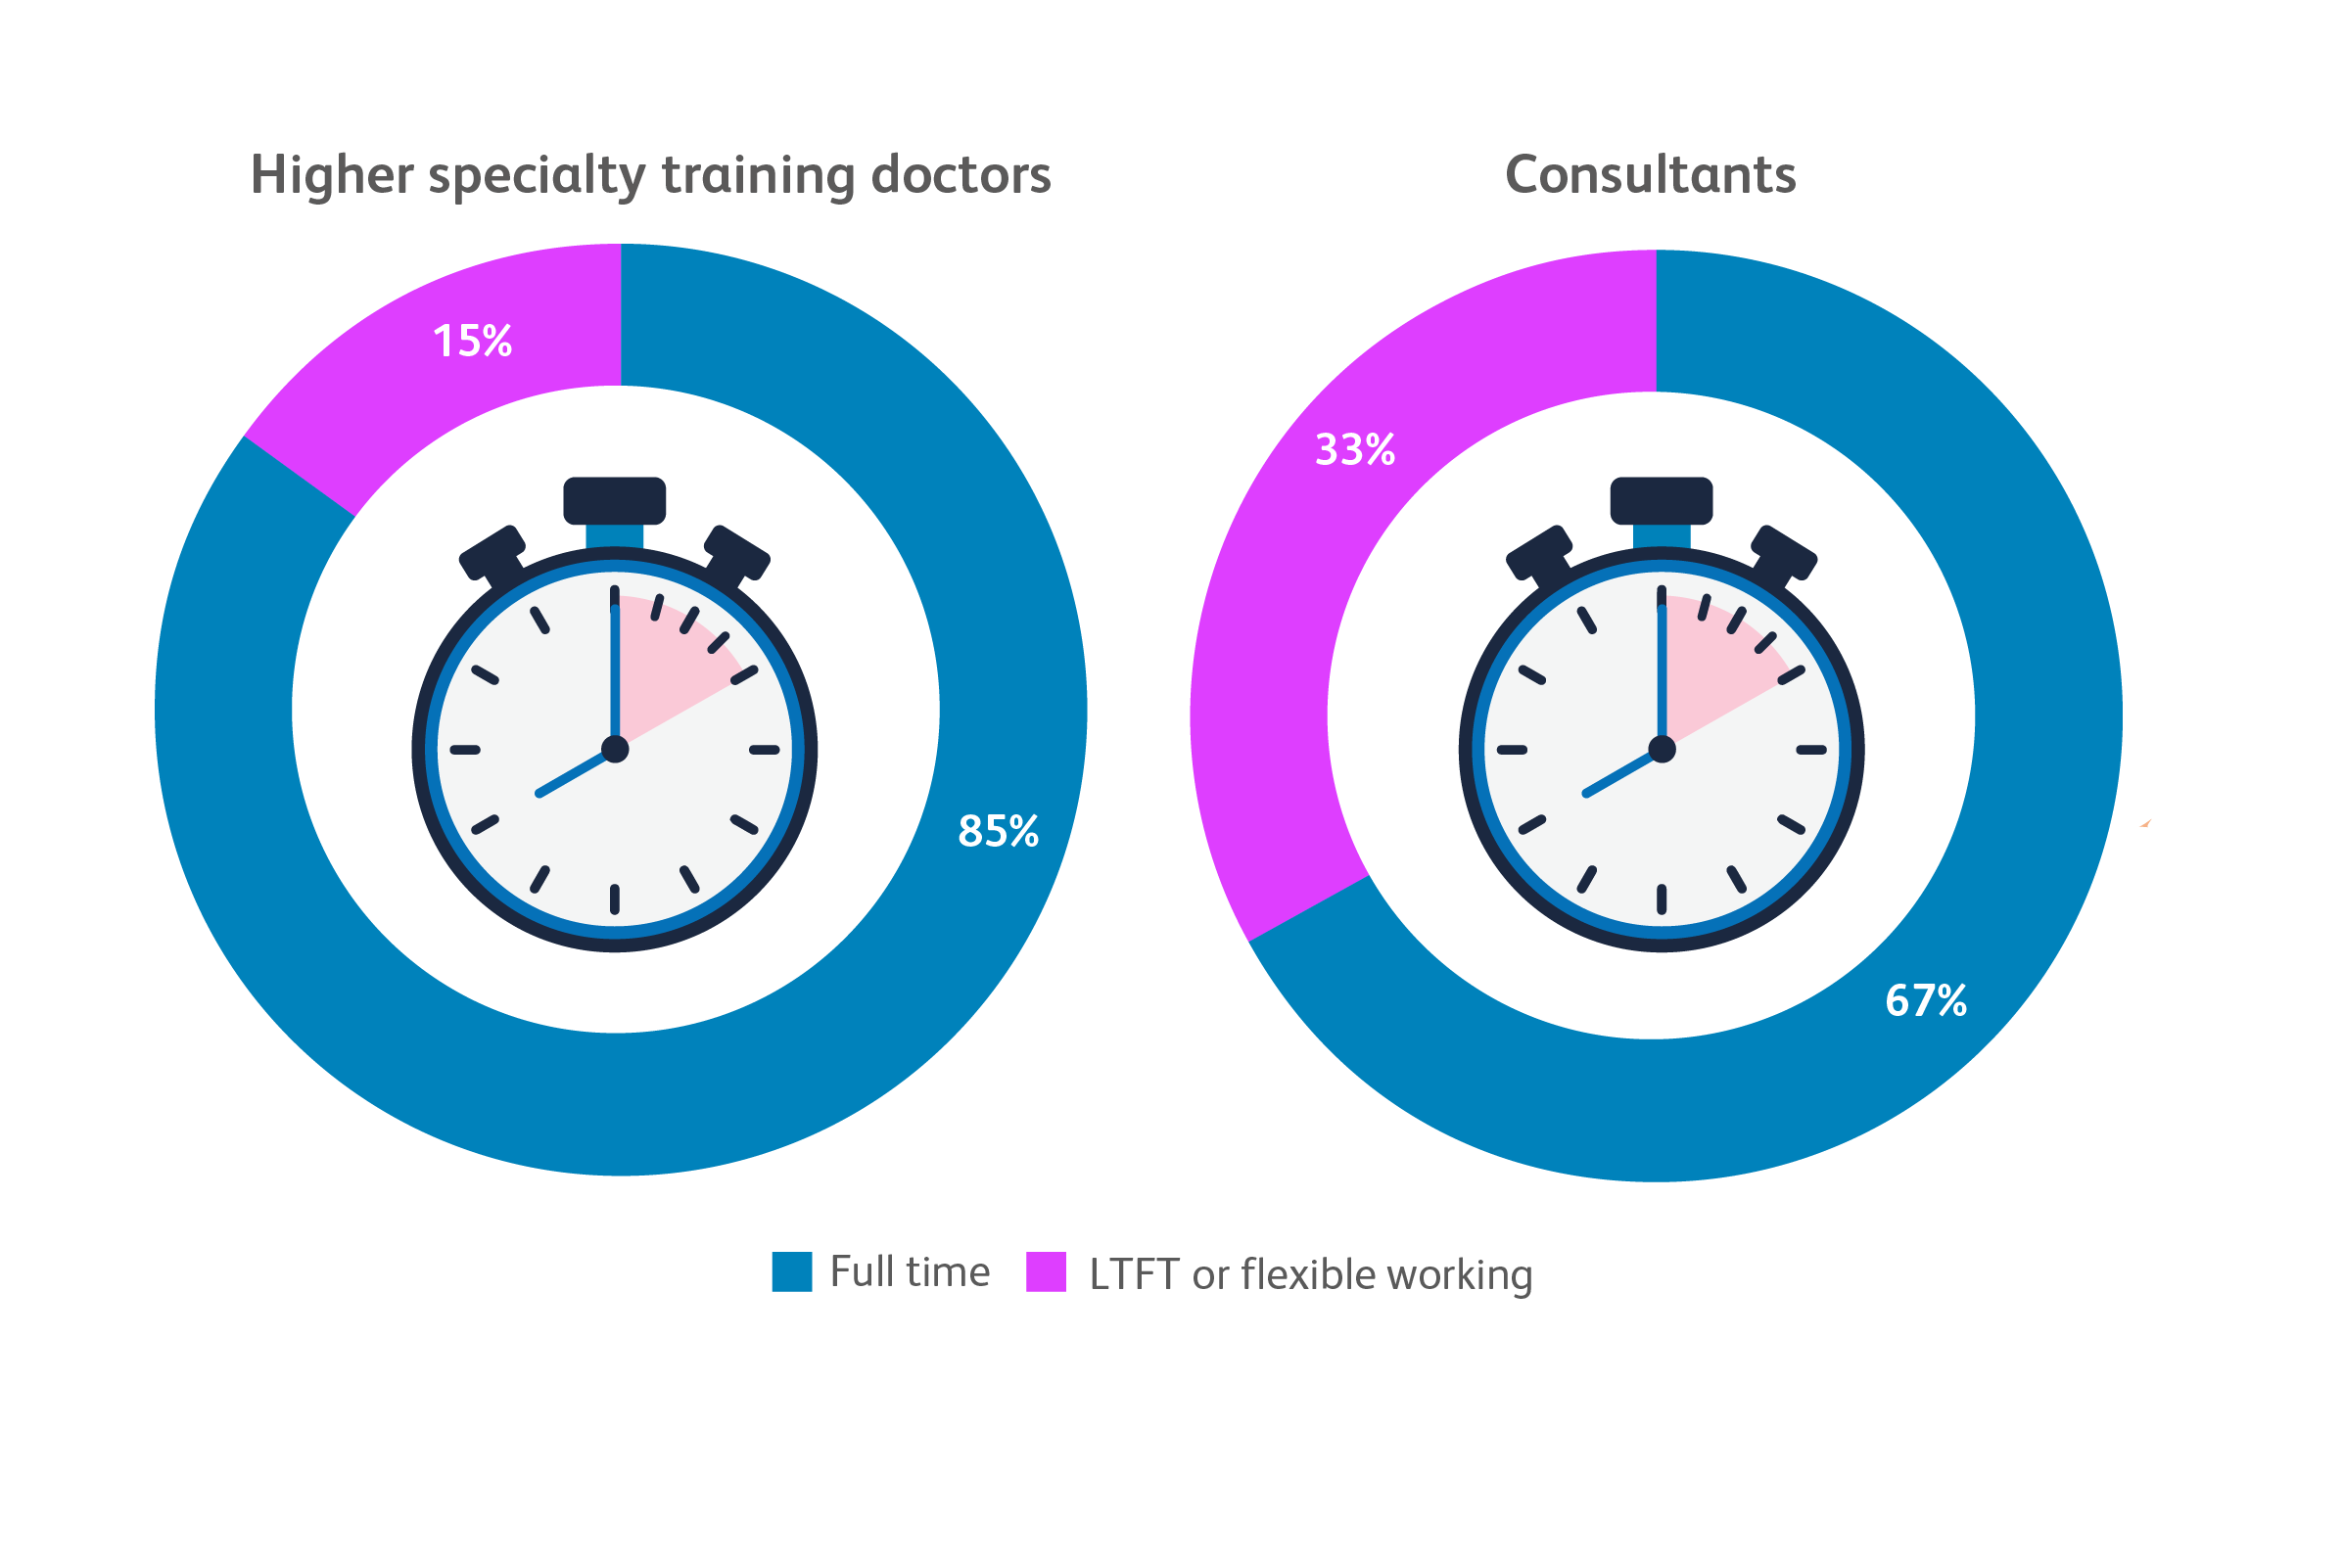
Full-time vs less-than-full-time and flexible working
Based on 8,484 higher specialty training
doctors from the JRCPTB database
Notes:
CHART IN S/S

Slide 7
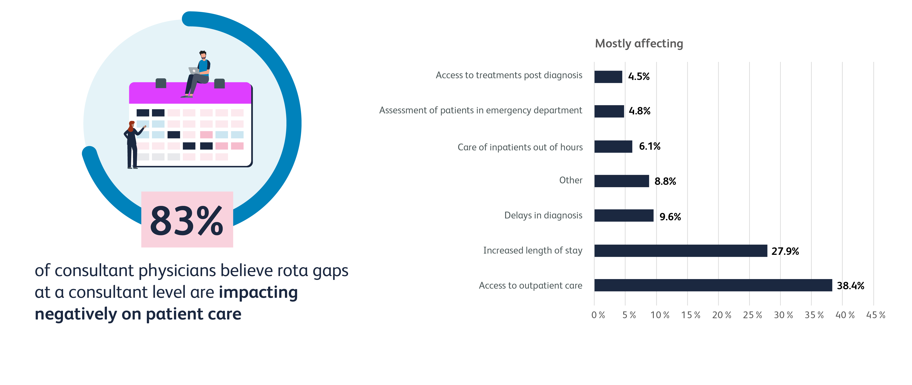
Consultants’ views on the impact of rota gaps at consultant level
Based on 926 consultant respondents
Notes:
Look at S/S

Slide 8
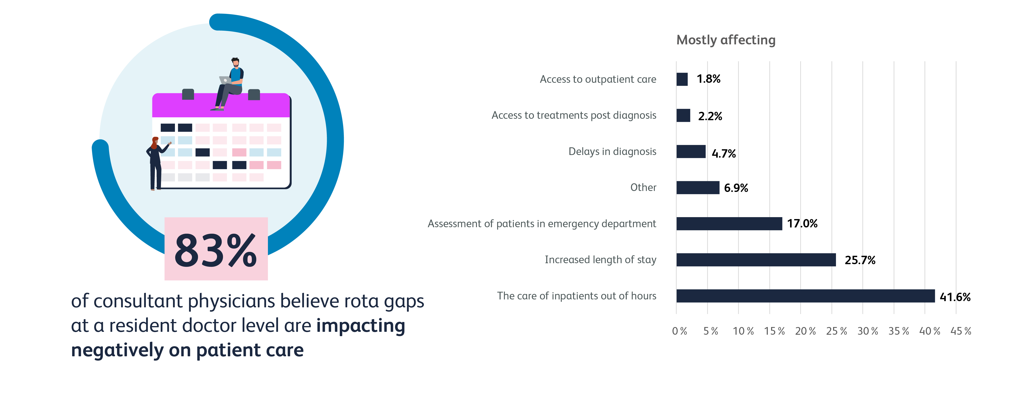
Consultants’ views on the impact of rota gaps at resident doctor level
Based on 3,024 consultant respondents

Slide 9
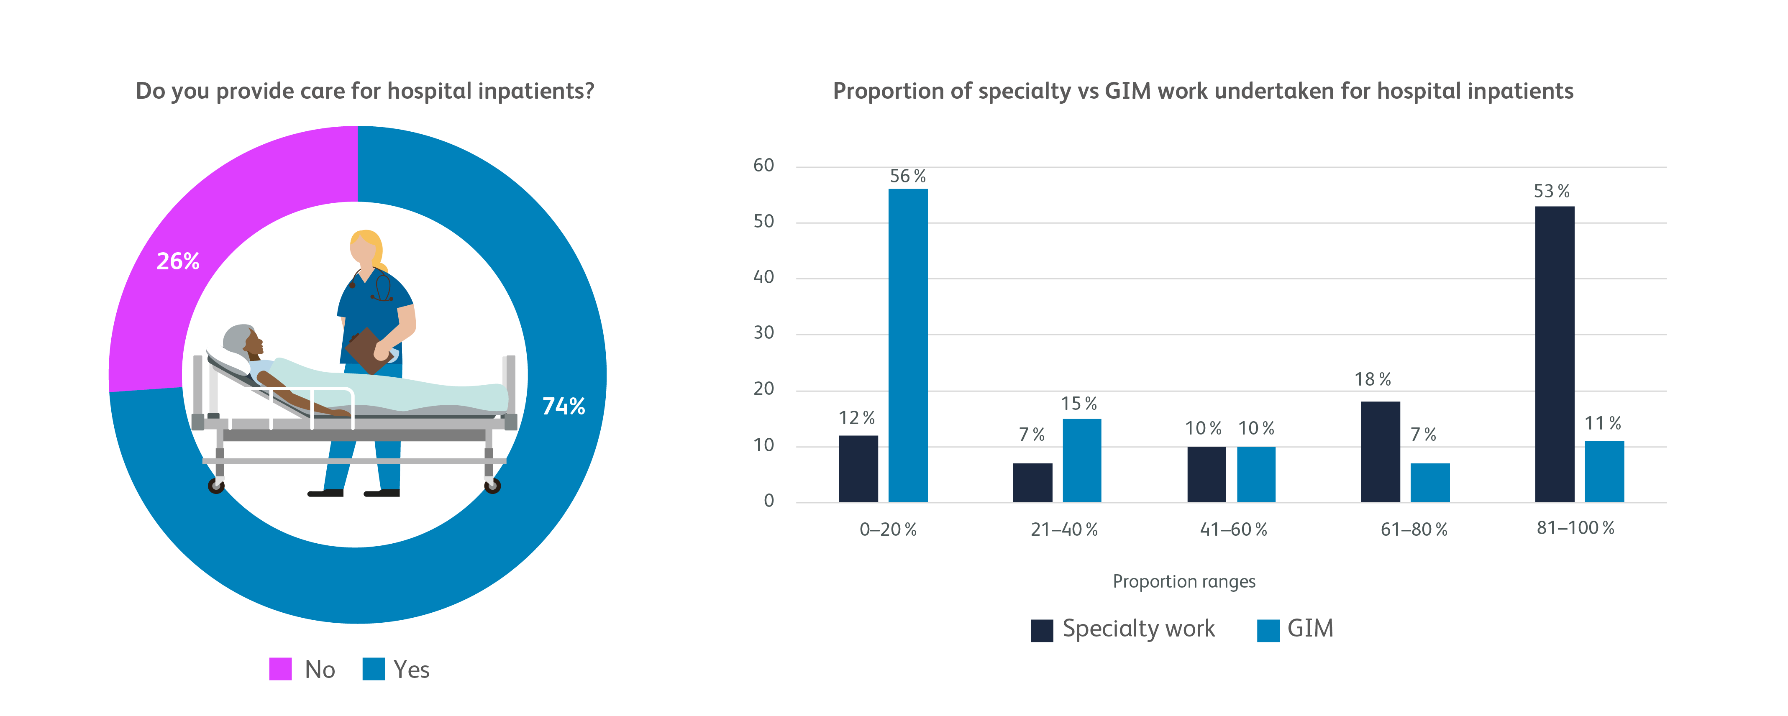
Caring for hospital inpatients
Based on 1,453 consultant respondents
Based on 1,037 consultant respondents

Slide 10
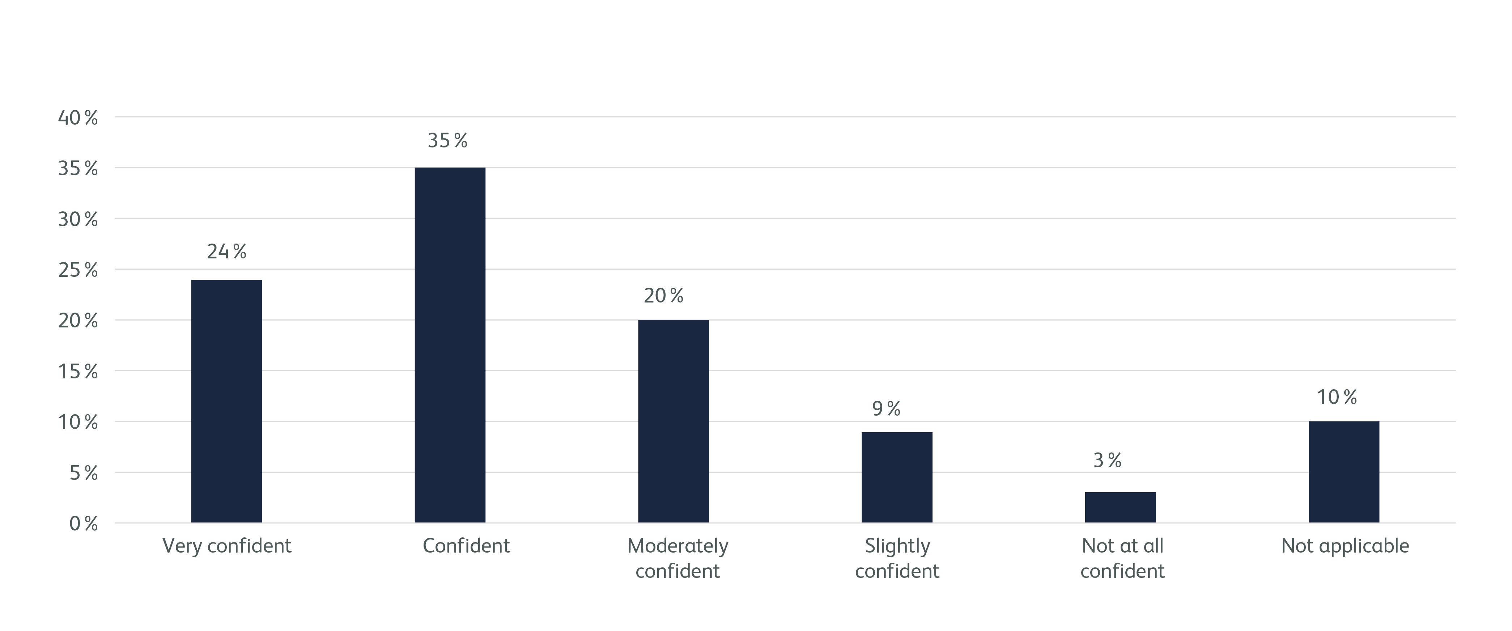
How confident do you feel in managing most general medical problems in inpatients?
Based on 1,070 consultant respondents

Slide 11
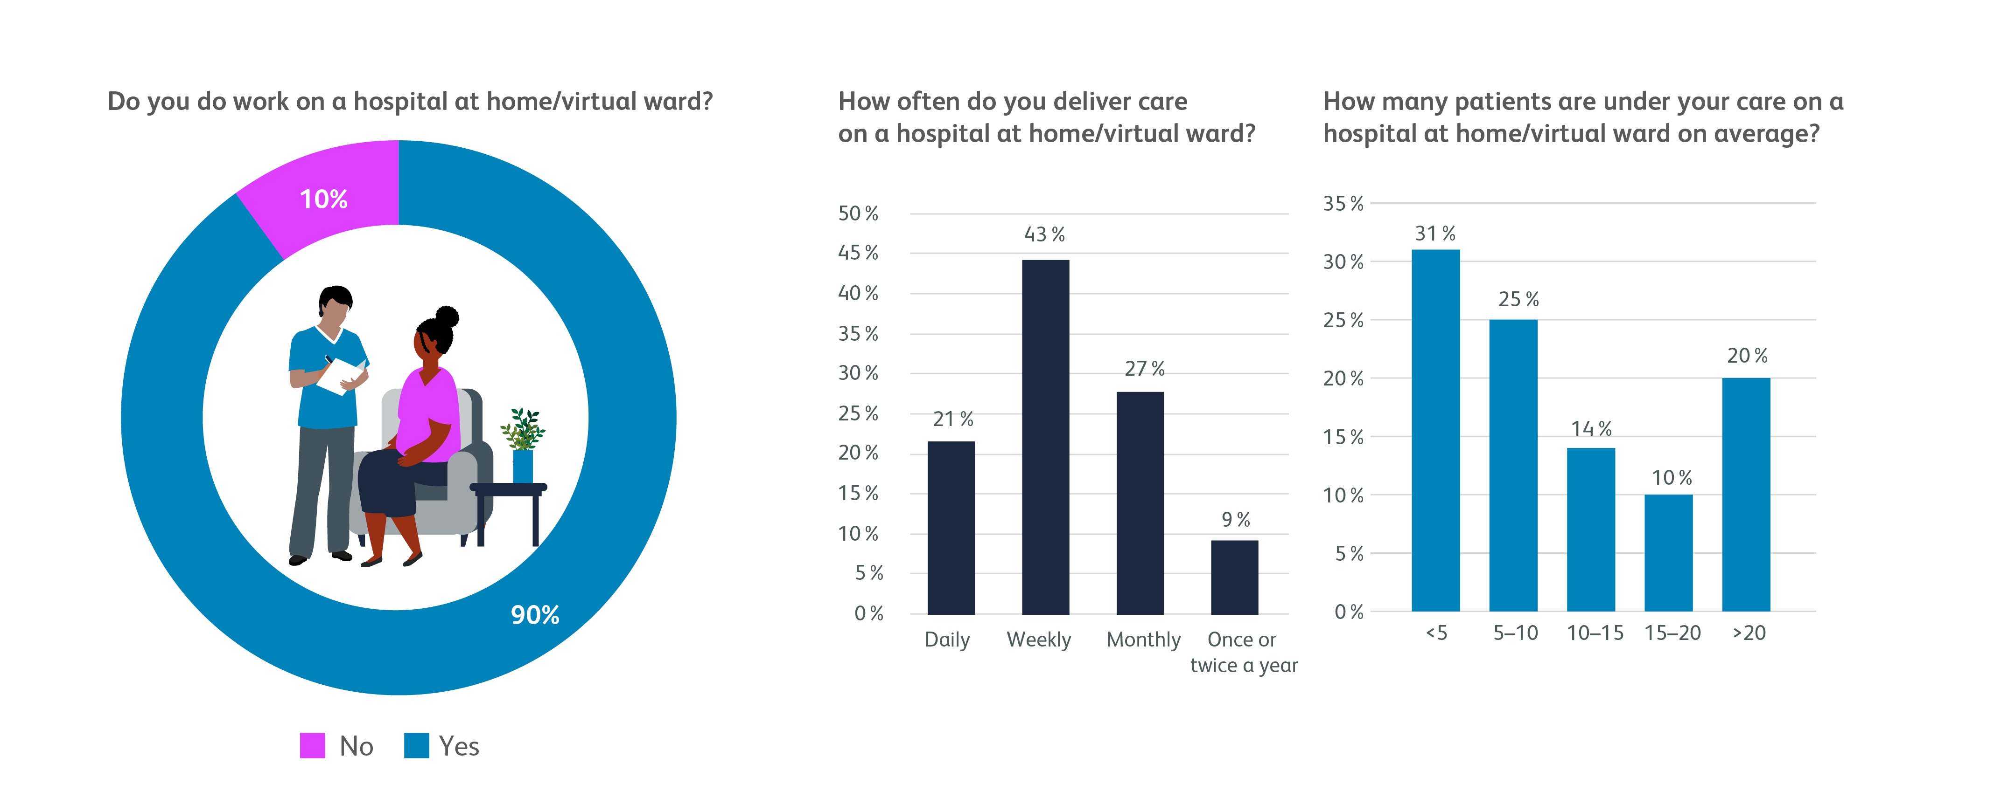
Hospital at home and virtual wards
Based on 1,449 consultant respondents
Based on 140 consultant respondents
Based on 140 consultant respondents

Slide 12
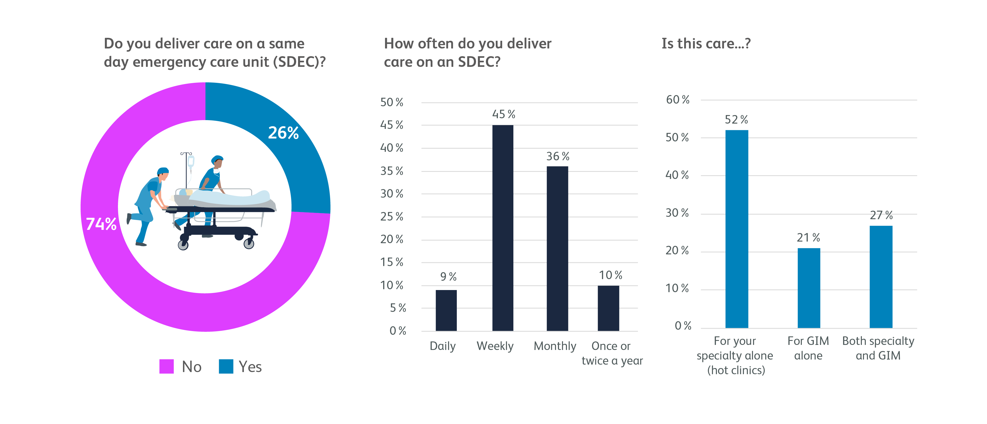
Same day emergency care
Based on 1,411 consultant respondents
Based on 361 respondents
Based on 357 respondents

Slide 13
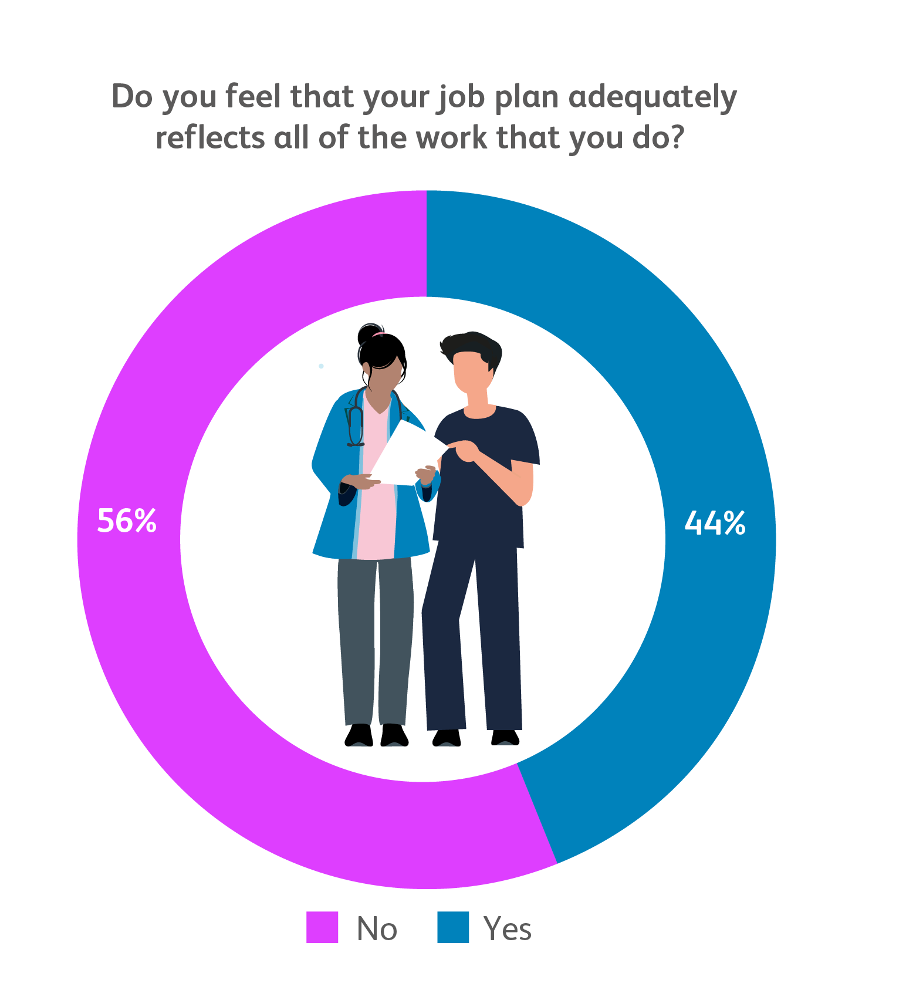
Job plans
What are the top three activities that get squeezed out of your week when things get too busy?
Continuing professional development
Quality improvement activity
Education, training and supervision of doctors (of all grades, including appraisal of colleagues)
Based on 1,802 consultant respondents
Based on 1,466 consultant respondents

Slide 14
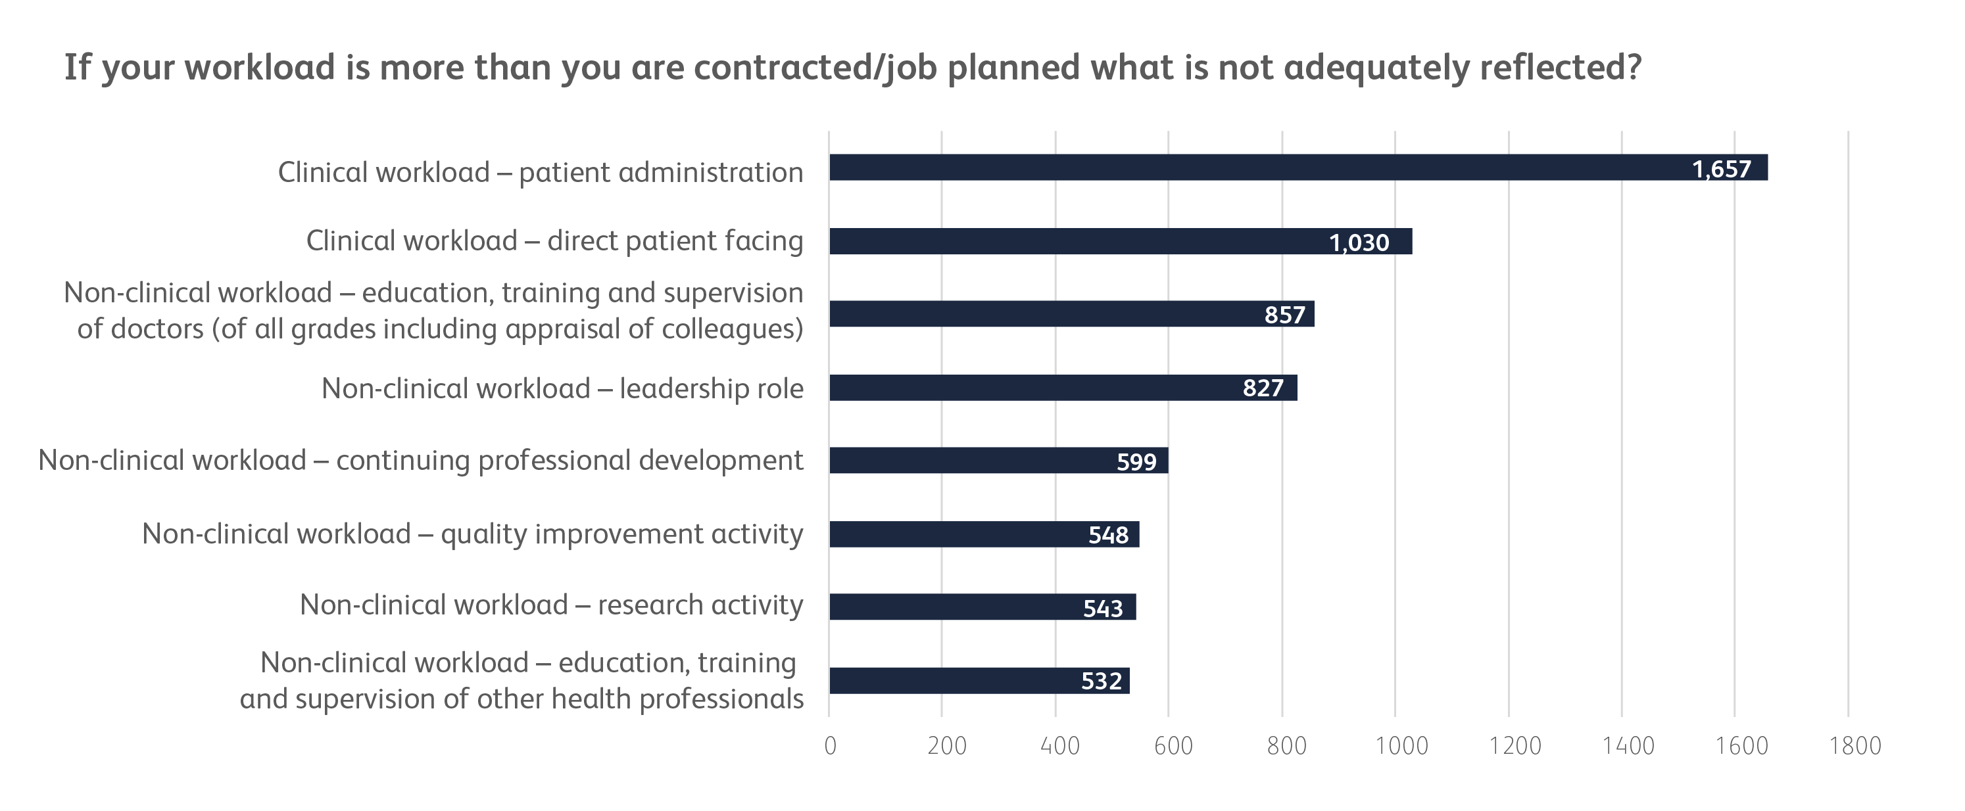
Job plans (continued)
Based on 1,802 consultant respondents to a multi-choice question

Slide 15
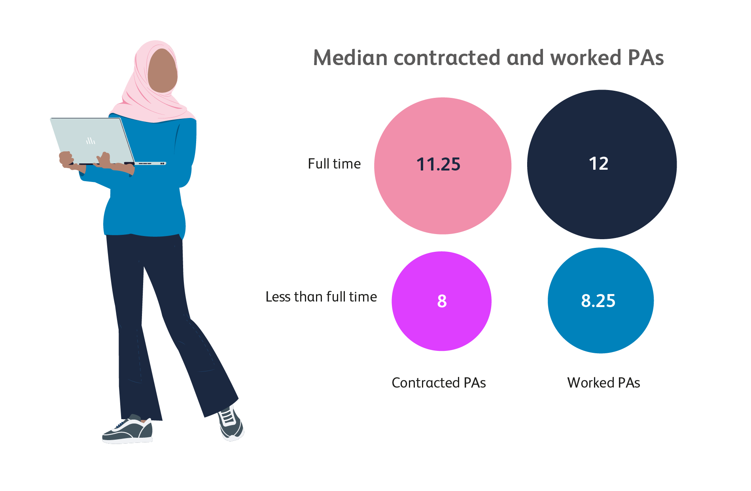
Median contracted and programmed activities (PAs) of consultants
Based on 1,469 consultant respondents

Slide 16

Consultant morale
Top three factors negatively affecting wellbeing at work
Clinical workload
Poorly functioning IT equipment
Lack of administrative support
Top three positive changes that would make the biggest difference to your wellbeing at work*
Well-functioning IT equipment
Fewer administrative tasks
Reduced clinical workload
Based on 1,398 consultant respondents
* Only 3 options could be selected

Slide 17
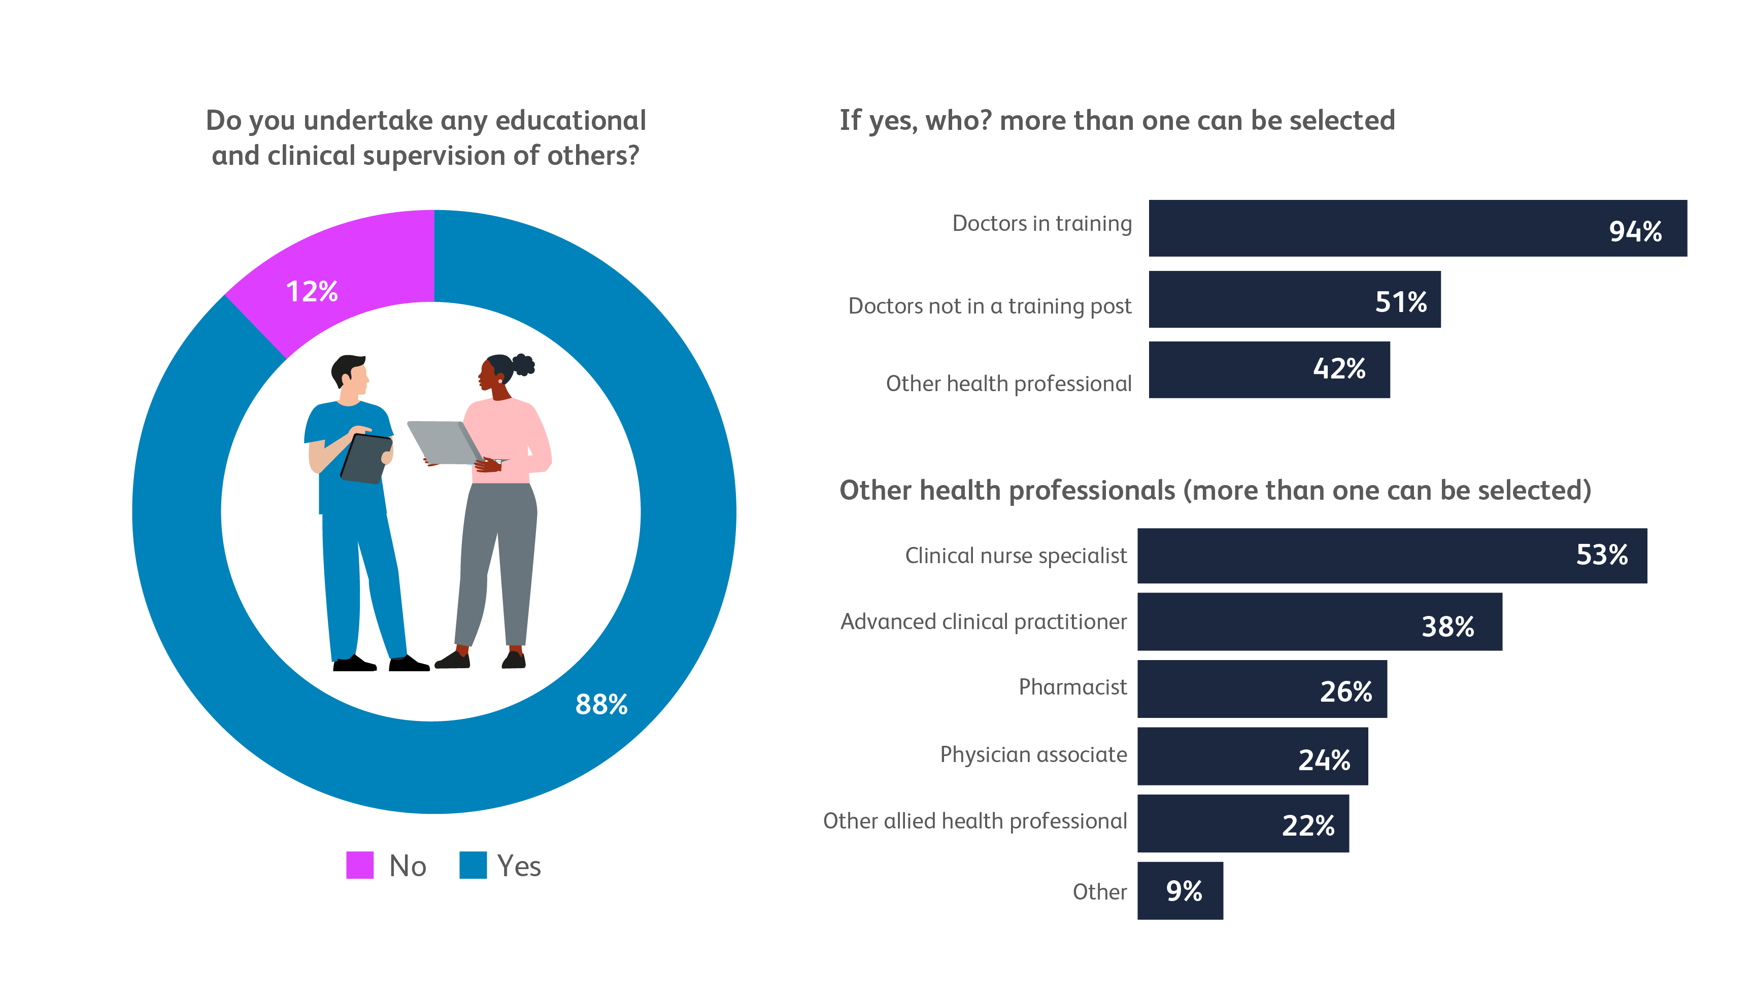
Educational and clinical supervision
Based on 1,251 consultant respondents
Based on 530 consultant respondents
Based on 1,422 consultant respondents

Slide 18
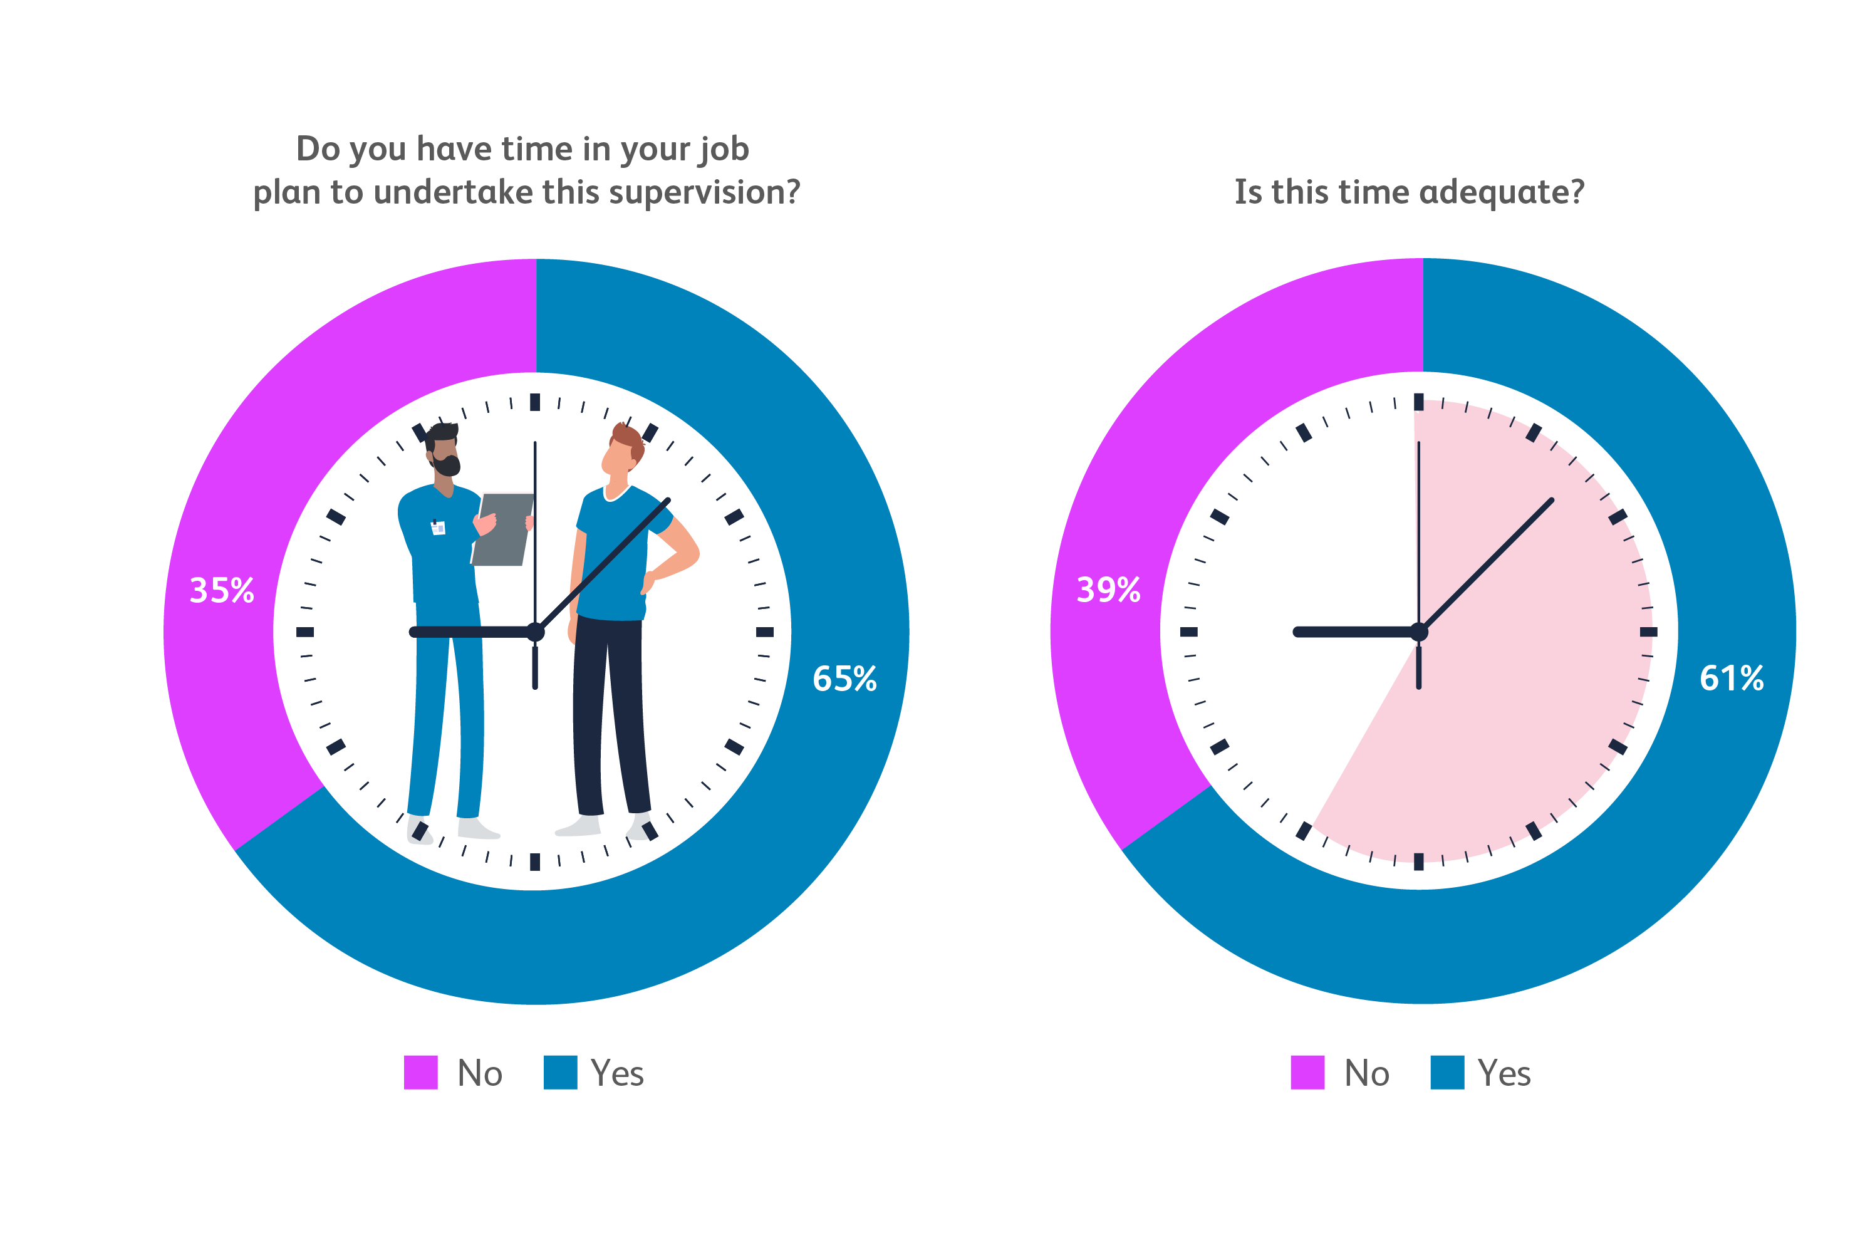
Educational and clinical supervision (continued)
Based on 1,248 consultant respondents
Based on 805 consultant respondents

Slide 19
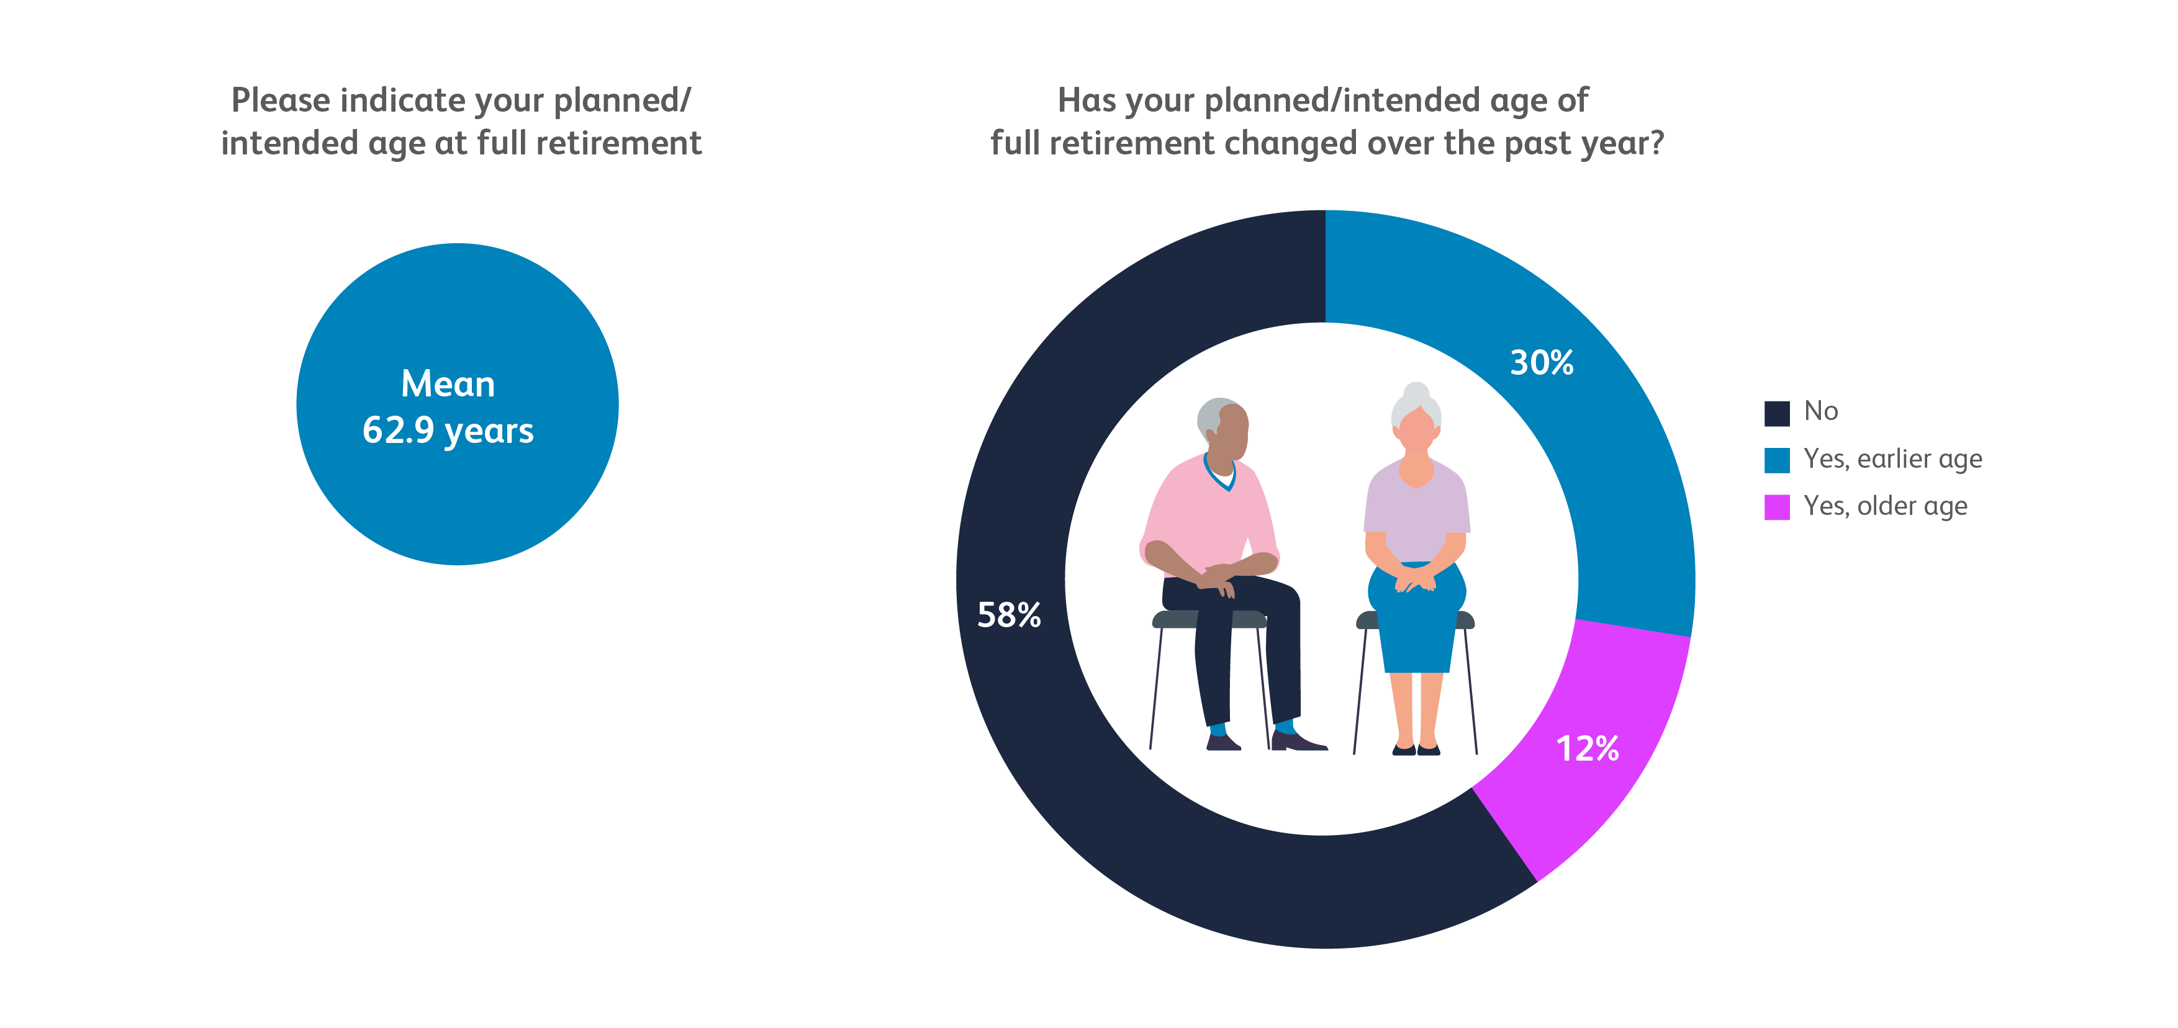
Consultant retirement
Based on 1,356 consultant respondents
Notes:
See S/S

Slide 20
Do get in touch medicalworkforce.datainsights@rcp.ac.uk

